Slide 1

CC-215 Database Systems
— Unit 3 — Data Models
Some slides and/or pictures are adapted from Lecture slides / Books of
Peter Rob
Jeffery. A. Hoffer
Thomas M. Connolly
Ramez Elmasri
Silberschtaz
Dr. Asif Sohail University of the Punjab Department of Information Technology, FCIT

Slide 2
Project
Identification
& Selection
Purpose: To develop a preliminary understanding of the business situation that has caused request for a new / enhanced IS
Deliverable: A formal request to conduct a project to design & develop an IS
Project
Initiation
& Planning
Purpose: To state business situation & how IS might solve problems
Deliverable: A written request to study the possible changes to existing system / the development of a new system
Analysis
Purpose: To analyze business situation to determine requirements., to structure requirements
Deliverable: A functional specs of the system
Logical Design
Purpose: To elicit & structure all information requirements
Deliverable: Detailed functional specs of all data, forms, reports, displays and processing rules
Physical Design
Purpose: To develop all technology & organizational specs
Deliverable: Program & DB structure, technology purchases, physical site plans and redesigns
Implementation
Purpose: To write programs, build data files , install new system, train users
Deliverable: Properly working programs with specs, and training material
Maintenance
Purpose: To monitor the operation and usefulness of system, to repair and enhance it
Deliverable: Periodic audits of the system

Slide 3
Project
Identification
& Selection
Analyze current data processing, general business functions and their database needs
Project
Initiation
& Planning
Analysis
Conceptual Data Model
Logical Design
Logical Data Model
Physical Design
Internal Data Model
Implementation
Physical Data Model
Maintenance

Slide 4
Types of Data Models
1. Conceptual Data Model
It defines WHAT the system contains?
It identifies entities, their attributes and their relationships (E-R Model).
2. Logical or Representational Data Models
Defines HOW the system should be implemented regardless of the DBMS.
Define the structure of data elements and the relationships between them.
a) Hierarchical Data Model
b) Network Data Model
c) Relational Data Model
3. Internal Data Model
Describes the database specific implementation of the data model
Create table Product (
Prod-Id Character(6) PRIMARY KEY,
Prod-Name Character(30), …);
4. Physical Data Model
Describes the way data is stored on storage media
It requires the definition of both the storage devices and access methods.

Slide 5
Database Development Life Cycle
It is important to recognize that the stages of the database development life cycle are not strictly sequential, but involve some of amount of repetition of previous stages through feedback loops.
For example, problems encountered during database design may necessitate additional requirements collection and analysis.
Analyze User Environment
Develop Conceptual Model
Map Conceptual Model into Logical
Choose DBMS
Develop Physical Design
Implement System
Test System
Operational Maintenance

Slide 6
System Models
Webster’s Dictionary defines model as a “description or analogy used to visualize something that cant be directly observed”.
Models are abstraction of a more complex real-world object or event.
The System models are the graphical representation of a System.
Models are more understandable than detailed natural language description of the system.
Model is an effective communication tool use for communication with different stakeholders of the system as per their needs.
Models are an abstraction of the system. It leaves out details.
Models are helpful for:
Testing a physical entity before building it
Communication with the customer
Visualization
Reduction of Complexity
Concept building and understanding

Slide 7
Data Models
A data model is a relatively simple representation, usually graphical, of more complex real-world data structures.
Data model is an architecture that organizes the various sections of data and manages how data elements are related to each other.
A data model is an integrated collection of concepts for describing and manipulating data, relationships between data, and constraints on the data in an organization.
It is the first step in designing a database.
It is unlikely to create a good database without first selecting an appropriate data model.
Two main purposes of data modeling are to assist in the understanding of the data (semantics of data) and to facilitate communication about information requirements.
Data Models are governed by the business rules of an organization.
A business rule is a brief and precise description of policy or principle of an organization.

Slide 8
Components of Data Models
A data model has the following three components:
Structural Part: How the data are structured?
Manipulative Part: Defines the types of operations that are allowed on the data. This includes the operations that are used for updating or retrieving data and for changing the structure of the database.
Integrity Constraints. Defines the checks that are used to ensures correctness of data.
The basic building blocks of all the data models are entities, attributes, relationships and constraints that are determined on the basis of business rules of an organization.

Slide 9
Entity
An Entity is an Object, Event, Persons, Place or Concept about which the organization wishes to maintain data.
An Entity Type or Entity Class is a collection of entities that can described under the same set of characteristics.
An Entity Instance is a single occurrence of an entity type.
Generally, an entity in the real world is defined under a single entity type, but sometimes an entity may fall in more than one entity classes.
For Example: Doctor and Patient Entity Class, Student and Faculty Entity Class etc.
An Entity is diagrammatically represented as
STUDENT

Slide 10
Attribute
An Attribute is a property or characteristics of an entity type that is of interest to the organization.
The other terms used for attribute are feature used in machine learning, dimension used in data warehousing and variable used in statistics.
Attribute
ENTITY
The attributes of a entity are selected on the basis of information requirements of an organization. For Ex, the attribute of a product for Sales Department will be different than that for Manufacturing Department.
A set of attributes used to describe an entity is called an attribute vector.

Slide 11
Attribute
Each entity in an entity class must posses at least one attribute (identifier) that distinguishes it from other entities in the same entity class.
Domain of an attribute is a set of permitted values for an attribute OR Domain is a pool of value from which an attribute extracts its actual value.
Null Value of an attribute means the absence of value. Some less important attributes of an entity may be allowed to accept null values. Such attributes are called optional attributes.

Slide 12
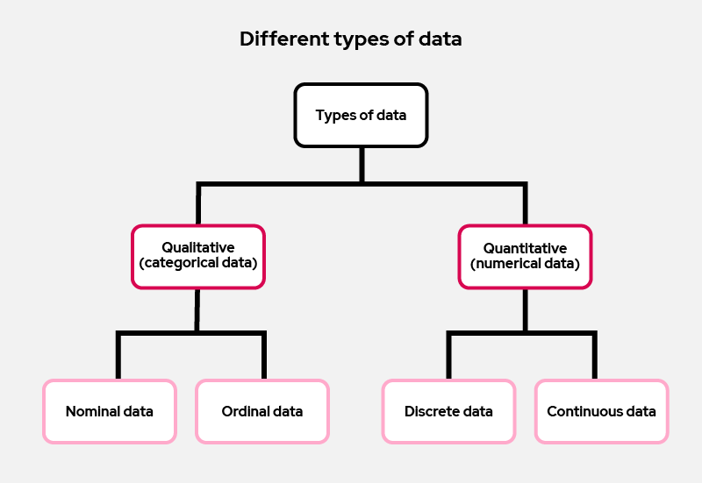
Attribute

Slide 13
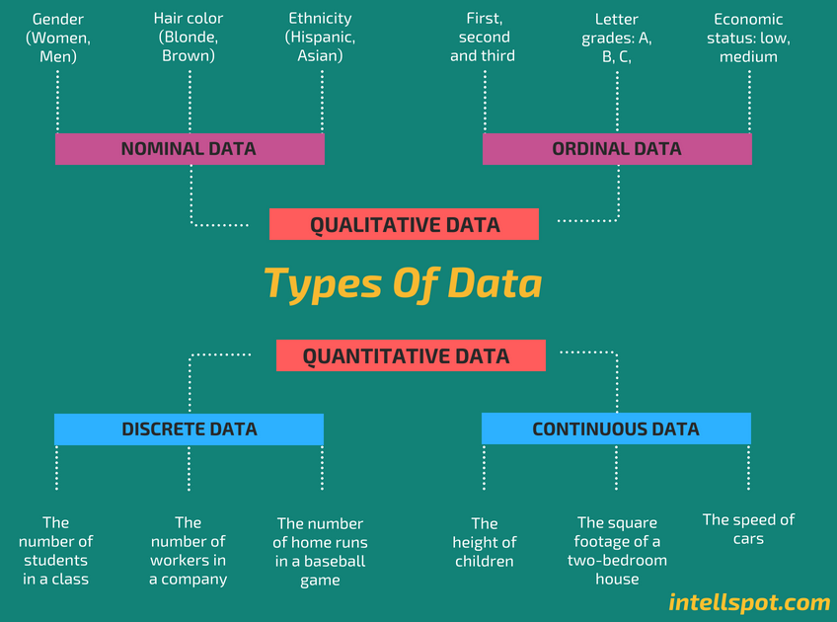

Slide 14
Types of Attributes
1. Qualitative Data
a) Nominal Attributes:
The attributes used to put entities into categories.
Predefined set of values.
Examples: Occupation, Marital-status, Province etc.
Nominal attributes may be represented using numbers, however, mathematical operations on nominal attributes are not meaningful.
Binary Attributes:
A binary attribute is a special case of nominal attribute with only two categories.
Examples: Class-attendance-status, gender etc.

Slide 15
Types of Attributes
1. Qualitative Data
b) Ordinal Attributes:
An ordinal attribute is an attribute with possible values that have a meaningful order or ranking among them, but the magnitude between successive values may not be known.
Examples: Grade, drink-size (small, medium, large)
Describe a feature of an object without giving an actual size or quantity.

Slide 16
Types of Attributes
2. Quantative or Numeric Data:
a) Discrete Attributes:
The discrete data are countable and have finite values.
Examples: Number of students in a class, Number of leaves of an employee, etc.
b) Continuous Attributes:
Continuous data represents information that can be divided into smaller levels or infinite values.
Examples: Height of a person, Speed of a vehicle, etc.

Slide 17
Binary Classes of Attributes
Required Attribute / Optional Attribute
Atomic Attribute / Composite Attribute
Single Valued Attribute / Multi-valued Attribute
Base Attribute / Derived Attribute
Discrete Attribute / Continuous Attribute

Slide 18
Binary Classes of Attributes
Required Attribute: An attribute of an entity that must have a value for each entity instance
Optional Attribute: An attribute of an entity that may/may not have a value for every entity instance.
Name*
Mobile_Number^{O}
Required Attribute
STUDENT
Optional Attribute

Slide 19
Binary Classes of Attributes
Atomic Attribute: An attribute which can’t be further subdivided into further meaningful attributes. For Ex: Price of a product.
Composite Attribute: An attribute which can be broken into further meaningful attributes.
For Ex: Address of a student.
H_No
St_No
Address
Area
EMPLOYEE
City

Slide 20
Binary Classes of Attributes
Single Valued Attribute: An attribute which has one and only one value against an entity instance. For Ex: RegNo of a Student, Pno of a product etc.
Multi valued Attribute: An attribute that may take on more than one values for a given entity instance.
Phone_No
Skills
EMPLOYEE

Slide 21
Binary Classes of Attributes
Single Valued Attribute:
Base Attribute: an attribute that is stored in the database.
Derived Attribute: An attribute whose value can be calculated from related attribute values.
EMPLOYEE
Base Attribute
Derived Attribute
Date_Employed
Years_Employed

Slide 22
Logical Data Models
Hierarchical Data Model
Network Data Model
Relational Data Model
Object Oriented Data Model
Object Relational Data Model

Slide 23
Evolution of Data Models
The data models have evolved in response to meeting the following objectives:
The need to provide greater independence between programs and data.
The desire to manage increasingly complex data types and structures.
The desire to provide easier and faster access to data.
The need to provide ever more powerful platforms for decision support applications.
Generation | Data Models
First | Hierarchical & Network
Second | Relational
Third | Object Oriented, Object Relational
Fourth | NoSQL (Non Relational)

Slide 24
Evolution of Data Models

Slide 25
Evolution of Data Models

Slide 26
Evolution of Data Models

Slide 27
Hierarchical Data Model (HDM)
It is one of the oldest data model in which data are organized a top down structure that resembles a tree.
Terminologies:
Node (also called segment) corresponds to a record
Root Node: The top most node
Parent & Child Nodes
Leaf Node is a node having no children
Siblings: The children of same parent
Family of Nodes: All children of same node
Hierarchical Path is a path from root node to any node
Tree levels called segments (equivalent to records)
Height of a tree refers to no. of levels

Slide 28
Background of HDM
Hierarchical Data Model was developed in 1969 (Moon landing project).
The earliest DBMS were based on HDM.
It follows navigational approach (need to specify how the data is to be retrieved).
One of the most popular HDM was IBM’s Information Management System (IMS).
For this reason, the term HDM and IMS are sometime used interchangeably.

Slide 29
Strengths of HDM
Conceptual Simplicity: The relationship between the various layers of the model is logically simple.
Database Integrity
Efficiency: The HDM is very efficient when a database contains a large volume of data in 1:M relationship that are fixed over time.

Slide 30
Weaknesses of HDM
Duplication: HDM supports one-to-one and one-to-many association but doesn’t support many-to-many association.
Root Node dominates the other nodes and other nodes can’t exist independently.
Not capable to answer all sorts of queries with the same efficiency (Navigational approach requires the knowledge of hierarchical path).
Complex
The relationships are predefined (pointer based) and new relationships cannot be accommodated unless we redraw the model.

Slide 31
Network Data Model (NDM)
It is an extension to HDM.
It follows navigational approach (need to specify how the data is to be retrieved).
It was introduced to overcome the limited scope of the HDM.
In NDM, each node can be associated with an arbitrary number of nodes and there is no concept of root node.
Terminologies:
A relationship is called a Set.
Schema: Conceptual organization of entire database.
Subschema: View of an application

Slide 32
Background of NDM
The Conference on Data System Language (CODASYL) formed Database Task Group (DBTG) in 1960 for the standardization of DBMS.
It released an initial report on NDM in 1971
The Integrated DBMS is the most popular example of NDM.
It is also known as CODASYL System or DBTG System.
The ANSI Standard Planning and Requirements Committee (SPARC) augmented the database standards in 1975.

Slide 33
Strengths of NDM
Conceptual Simplicity: The relationship between the various layers of the model is logically simple.
Database Integrity
Handles more relationship types
Data Access Flexibility: An application can access an owner record and all member records in a set.

Slide 34
Weaknesses of NDM
Complex
Inflexible
System complexity limits efficiency—still a navigational system. It remains difficult to answer all sorts of queries with the same efficiency.
The relationships are predefined (pointer based) and new relationships cant be accommodated unless we redraw the model.
Lack of structural independence: Structural changes require changes in all application programs.

Slide 35
Reading Material
Database Systems – Design, Implementation and Management: Carlos Coronel, Steven Morris (13th Ed.)
Modern Database Management: Jeffery. A. Hoffer (12th Ed.)
Database Systems: Thomas M. Connolly (6th Ed.)
Fundamentals of Database Systems: Elmasri (7th Ed.)
Database System Concepts: Abraham Silberschatz (7th Ed.)
Databases Illuminated: Catherine M. Ricardo (3rd Ed.)
Book | Section(s) / Chapter
A | 1.4, 2.1 to 2.6
B | Ch1 (page 17 to 22), Ch3 (page 53 to 56)
C | 2.3
D | 2.1
E | 1.5, 1.9, 6.3
F | 1.6, 2.7, 3.3

